Slide 1
DATA SCIENCE CAPSTONE PROJECT Battle of Neighbourhoods - Waste in Lagos and London Oct 2020 Olumide Ojo-Oratokhai

Slide 2
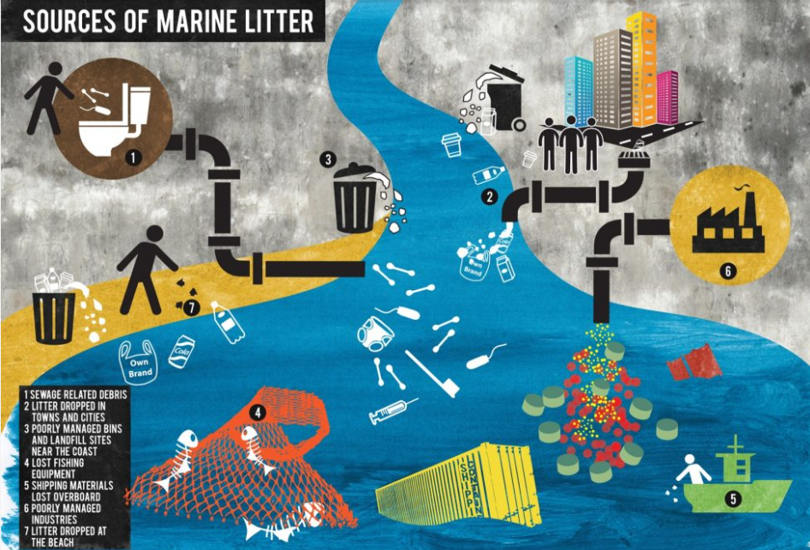
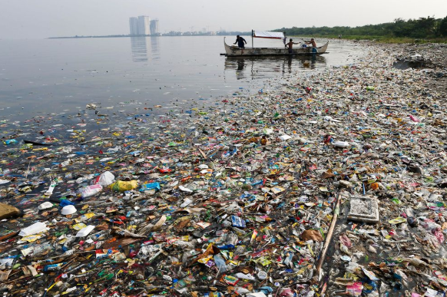
Introduction
The world is now better informed of the challenges of waste
This is an even bigger problem for major cities like Lagos and London
Can data from both cities highlight insights that can be shared across cities that can be helpful to address the issue?

Slide 3
Data – Restrictions and Limitations
There was an initial grand intention to use data of recycling facilities, supermarkets, factories and population to model waste within cities
In real terms, quality data for Lagos by Local Authorities(LAs)/Boroughs was limited and some API limitations on extractable data volume led to settling to focus on population and waste data for London and England and see if it can be reliable to model waste for Lagos

Slide 4
Methodology
Below are some tools employed within the project:
Data Acquisition: API calls were made to extract venue types and coordinates for recycling, supermarkets and factory venues in Lagos and London. Beautiful Soup package was used to create dataframe from Wikipedia page for Lagos population by LA. Files were read directly from ONS websites for England population and waste by LA.
Data Wrangling: Multiple codes were written to clean acquired data including changing headers, dropping columns and Na rows, reset indexes, and merging tables with Fuzzy-Merge package.
Exploratory Analysis: Descriptive statistics were obtained for Lagos, London and England data on population and household waste. Scatter plots, hbar charts and folium maps were employed to summarize acquired data in a audience friendly way.
Model Development: Linear, Polynomial and Exponential models were tried. Data were sometimes normalised before splitting to train and test sets before modelling.
Machine Learning: K-means method was used to cluster London and England LAs based on their population and waste generated.
Data Acquisition
Exploratory Analysis
Model Development
URLs
4SQR API Calls
Beautiful Soup
Data Cleaning
Fuzzy-merge
Descriptive stats
Data Visualization
Machine Learning
Regression Analysis
K-Means
General wrangling

Slide 5
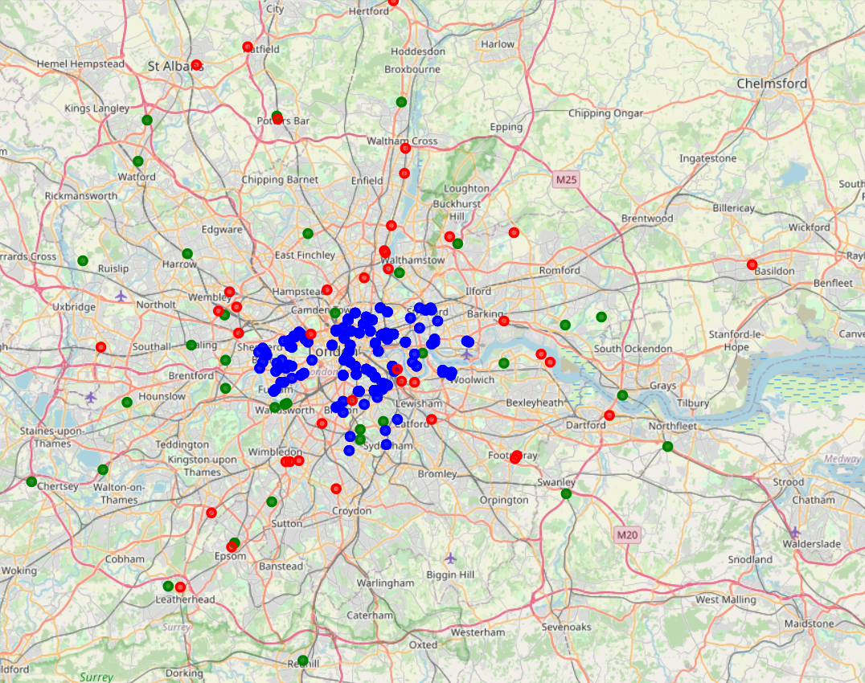
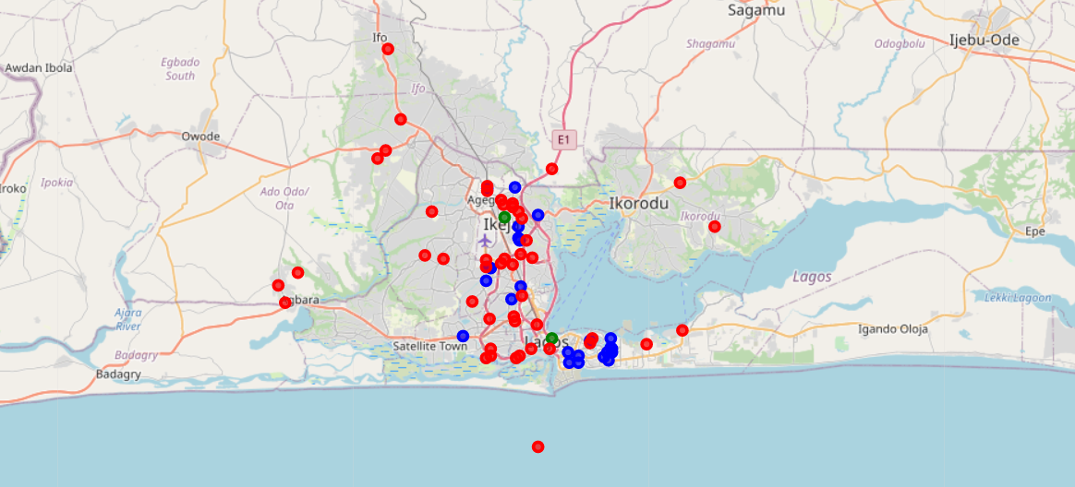
Results and Discussion – Lagos and London Waste Facilities, Supermarkets and Waste
Within 30km radius of Central Isolo Lagos, there are only 2 recycling facilities (green dots) according to 4SQR API, but 19 according to google. There are 24 supermarkets (Blue dots) and 47 industrial estates (red dots).
Within 30km radius of Tower of London, there are 35 recycling facilities and 40 industrial estates. Within just 6km radius of Tower of London there are 170 supermarkets.
Note: API calls results were limited to 50 results per call, so it was difficult to easily obtain all supermarket data within a larger radius. Also Lagos is expected to have more open markets not captured in the API.

Slide 6
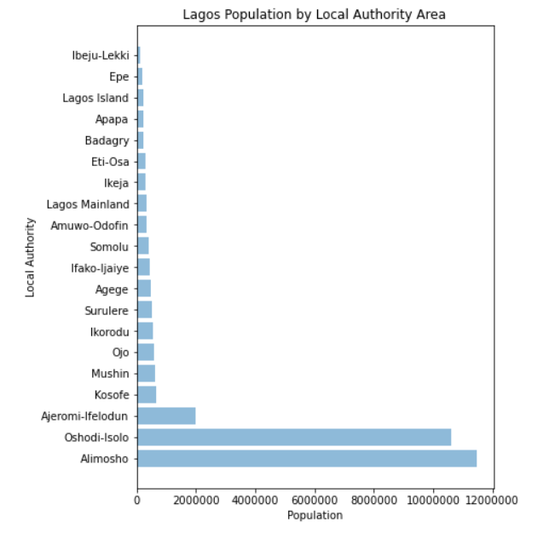
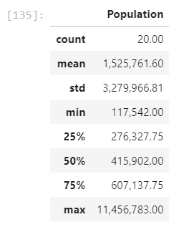
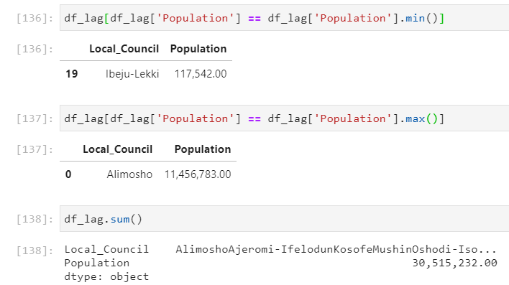
Results and Discussion – Lagos Population and Waste
Lagos has 20 Local Authorities with a total of 30.5mio people. This is an average of 1.5mio people per LA with Alimosho having the largest population of 11.5mio people.
Oshodi-Isolo is next with over 10.6mio people and Ibeju-Lekki with the smallest population of 117.5k people.
No sources were cited for this data on Wikipedia page, so its reliability is unknown. Also no reliable waste data was available. This website states some difficulty with getting reliable data on Lagos for waste and population. https://africacheck.org/reports/what-a-waste-fact-checking-four-claims-about-nigerias-garbage-problem/

Slide 7
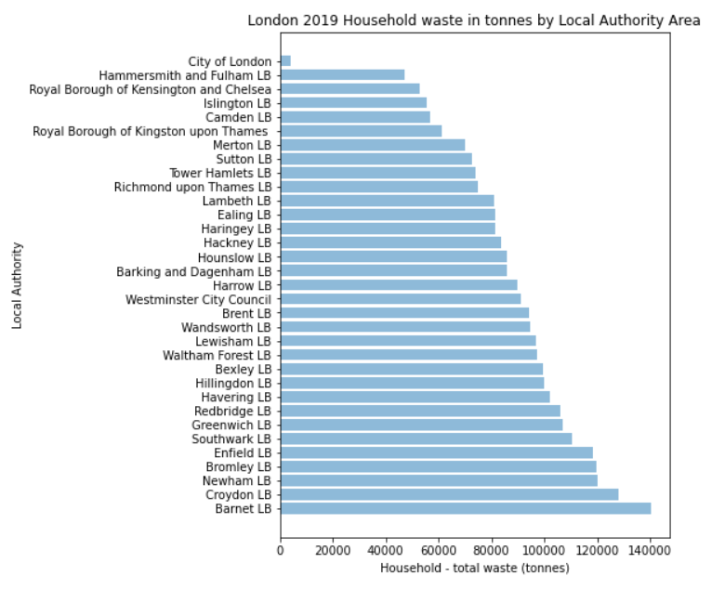
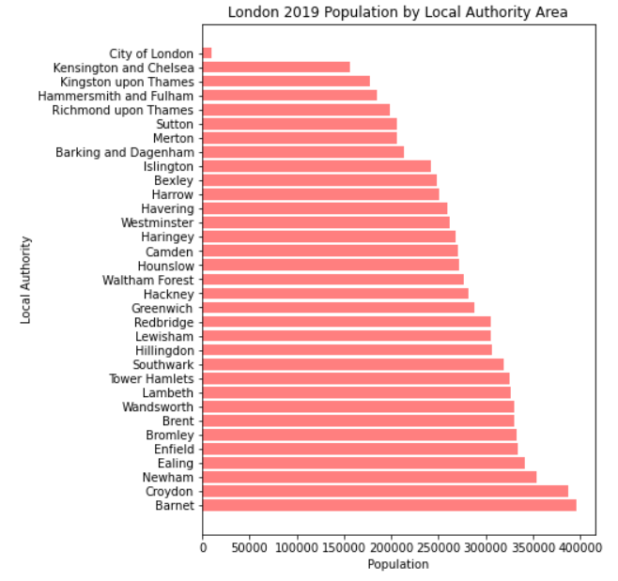
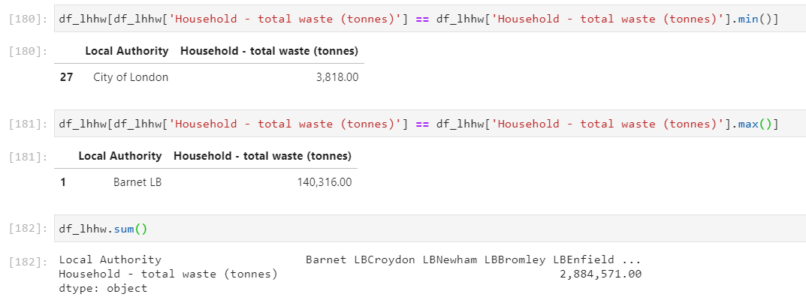
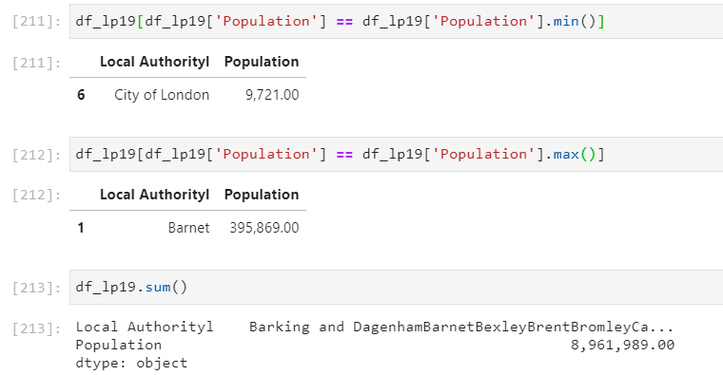
Results and Discussion – London Population and Waste
London’s 33 Local Authorities (LA) had a total population of 8.96mio people in 2019, averaging 271k per LA. Barnet was the largest with 395k people and City of London with only 9.7k people.
London’s 33 LAs produced a total of 2.88mio tonnes of waste per year (based on 2018/2019). This is an average of 87k tonnes per LA per year. Barnet produced the largest waste of 140ktonnes whilst City of London generated the least of about 3.8ktonnes per year.

Slide 8
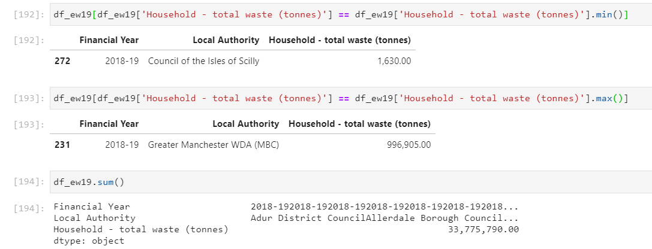
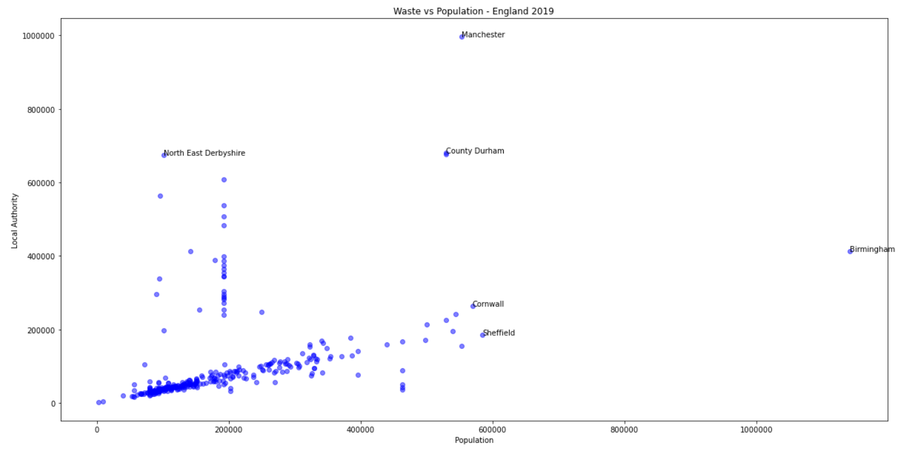
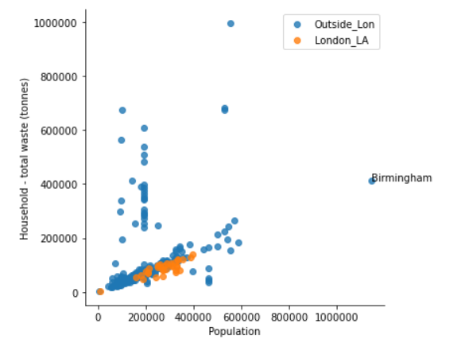
Results and Discussion – England Population and Waste
All England LAs generated 33.8mio tonnes of waste in 2018/19, making an average of 98k tonnes/ LA.
Manchester with a population of 553k people generated the largest waste of 997k tonnes, whilst Isles of Scilly generated only 1.6k tonnes.
Birmingham with 1.1mio people generated 412k tonnes of waste (less that half of Manchester’s)
London LAs are not the largest waste generators in England

Slide 9
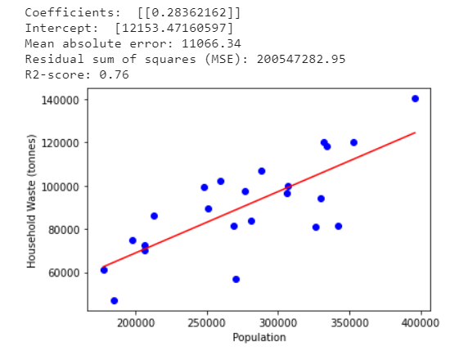
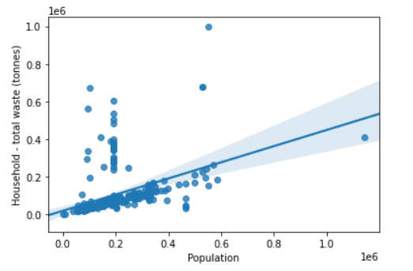
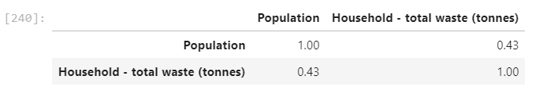
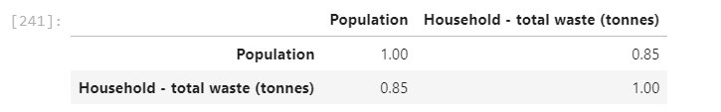
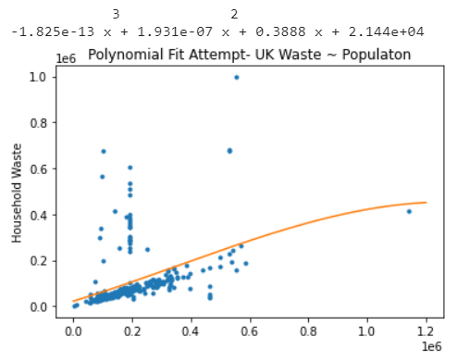
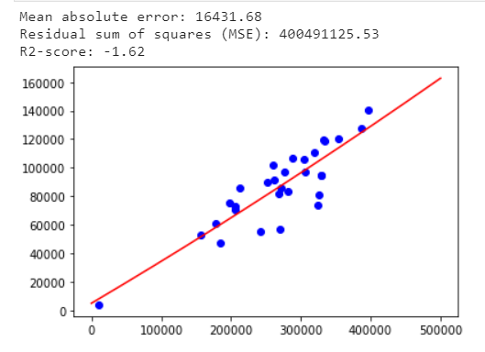
Results and Discussion – Regression Fits
There is a reasonable positive linear relationship between population and waste generated in London with a Pearson Correlation Coefficient of 0.85 and R2 of 0.76. But this is less so at the England National level with a PC coefficient of only 0.43. (Top row charts).
The negative R2 for a polynomial fit shows it will be less accurate at predicting waste with population. (Bottom row charts)

Slide 10
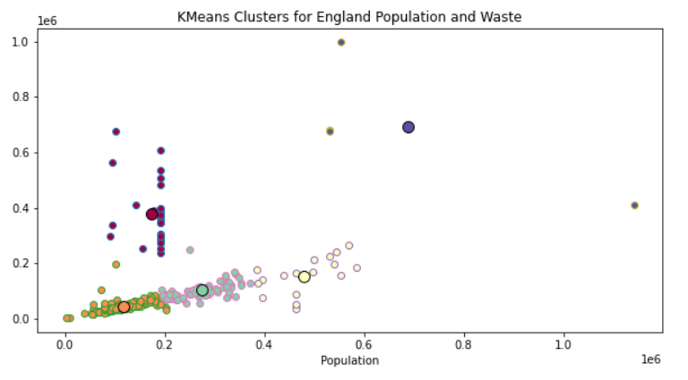
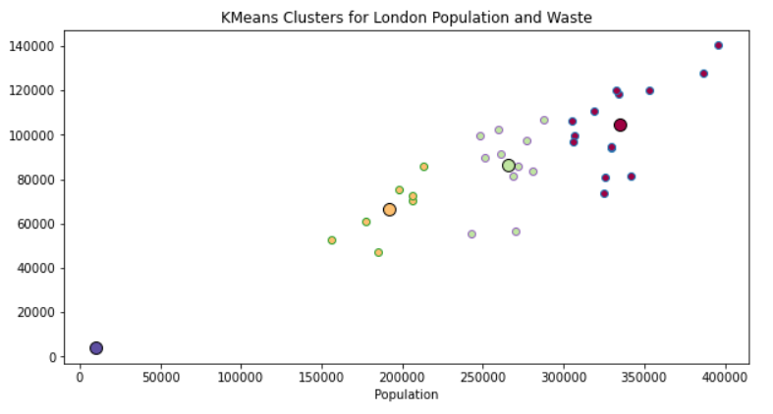
Results and Discussion – Cluster Analysis
For England, there seems to be 3 main clusters (Orange, Green, Yellow) with low waste levels (<300ktonnes/yr) and they are mainly low population. The intriguing clusters are low population with wastes above 300k tonnes. Birmingham makes for a fascinating learning with its high population but under 500k tonnes waste whilst Manchester may have new insights to learn from Birmingham’s ways of keeping waste low.
Within London, although all LAs produced under 200ktonnes of waste per year, there are 3 key clusters (Yellow, Green Wine). The Wine Cluster with the highest population (>300k people) generated between 70ktonnes and 140k tonnes of wastes within London. City of London which is mostly a business district with very few residential houses expectedly generated very low waste.

Slide 11
Conclusions and Recommendations
Conclusions:
London’s 33 LAs are middle of the pack with respect to population size and waste generation compared to other LAs in England. Barnet was the highest populated with 395k people and generated a waste of 140k tonnes of waste in 2019.
For context, Manchester with 550k people produced approximately 1mio tonnes of waste in 2019. Other high waste producing LAs in England were County Durham with 680k tonnes and North-East Derbyshire with 675k tonnes of waste.
Although Birmingham is the most populated LA with over 1.1mio people (double of Manchester), it generated only a moderate 412k tonnes of waste in 2019. (less than half of Manchester’s waste)
In London, there was a linear relationship between the population of LAs and the household waste they produced according to the model below. The model predicts that Lagos’ 30.5mio people will produce about 8.9 tonnes of waste in a year.
Waste/yr. (tonnes) = 0.28*(City Population) + 12153 error = (+/- 11066)
No linear, polynomial or exponential fit found for England population and household waste by LAs
The LAs to focus upon for improvement in England are those in the cluster of low population but high waste such as County Durham and North East Derbyshire.
Recommendations:
Test out the model on countries with known reliable information on waste and population. This can verify model reliability in predicting reliable waste for places with no reliable data like Lagos.
Consider using more attributes or parameters (like such as numbers of recycling facilities, supermarkets, packaging factories and lifestyle) to develop models with perhaps better R2 values and smaller errors.
Use Chloropleth to visualize population vs. waste on LAs heat map.

Slide 12
Thank You!

